Slide 1

Prediction of Over-the-Counter Products and Exercise as Home Treatment Modalities for Knee Joint Pain Using Deep Learning
Harry Onengiyeofori
Kancheti Chandrika
Mandalapu Sruthi
Nandigam, Venkata Mohana Rao
Suliman Abdurrhman
July 15, 2024
ThePhoto by PhotoAuthor is licensed under CCYYSA.
ThePhoto by PhotoAuthor is licensed under CCYYSA.

Slide 2
TABLE OF CONTENTS
Introduction
Problem Description
Overview of Multi Target Learning
Methodology
Data Generation Plan
Model Building
Architechure
Results
Future Work and Suggestions
References

Slide 3
INTRODUCTION
According to [1] Knee joint pain affects accounts for about 4million primary care visits annually as it impacts about 25% of adults in the US.
10% - 16% of US adults suffer from knee osteoarthritis, [2] making it the most common source of knee pain, within the US.
More than half of patients with knee osteoarthritis utilize over-the-counter (OTC)pain medication. [2]
Therapeutic exercise is often recommended as means of treatment.[2]

Slide 4
INTRODUCTION
This project explores how deep learning can be utilized to enhance the effectiveness and personalization of these treatments.

Slide 5
PROBLEM DESCRIPTION
Generate synthetic tabular data to fit the given data model.
Build a deep learning multilabel classification model to predict user preferences of over-the-counter products and exercises.
Build a multi target learning model to predict over-the-counter products, exercises, and post pain levels.

Slide 6
MULTITARGET LEARNING
Multi-label classification: Given multiple classes, and multiple nonexclusive categories, an object can belong to multiple categories [4]. A simple example is tagging a photo with multiple labels like beach, sunrise, and friends.
Multivariate regression: It is used to measure the degree at which more than one independent variable (predictors) and more than one dependent variable, are linearly related. For example, to measure the correlation between the amount of time spent on social media and an employee's productivity.
Multi-task learning: A single shared machine learning model that can perform multiple different tasks. One example is a spam-filter, different people have different distributions of features which distinguish spam emails - an English speaker may find that all emails in Russian are spam, not so for Russian speakers.

Slide 7
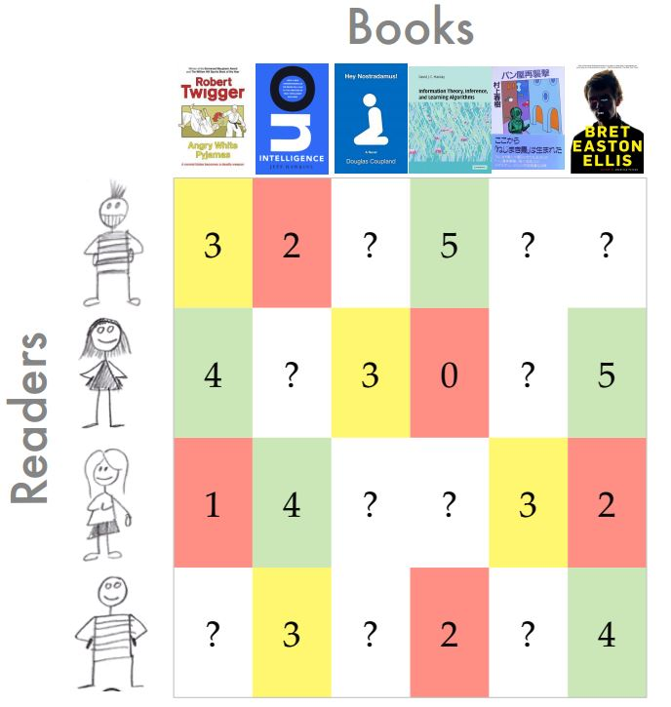
MULTITARGET LEARNING
Multi-target learning, also known as multi-output learning, where the goal is to predict multiple target variables simultaneously. For example, a patient's medical data (e.g., age, blood pressure, cholesterol levels, etc.) can be used to predict the likelihood of multiple diseases such as diabetes, hypertension, and heart disease simultaneously.

Slide 8
SYNTHETIC DATA GENERATION
We can generate data from either initial data or statistical methods.
We utilize statistical models that utilize statistical or probabilistic models to simulate real data[3], since actual data is unavailable.
We utilize distributions from past research on knee pain as impetus for deciding how to generate distributions.

Slide 9
METHODOLOGY
Methodology

Slide 10
DATA & MODEL BUILDING PLAN
Phase 1:
Generate baseline correlated multilabel synthetic data based on the provided data model using "make_multilabel_classification" function sklearn.datasets
Build baseline multilabel models

Slide 11
DATA & MODEL BUILDING PLAN
Phase 2:
Utilize actual socio-economic data, health data, and available probabilities from research to generate a final dataset
Test generated data for multiclass classification using Back Propagation Neural Network
Build multi target learning model to predict otc products, excersise, and postpain

Slide 12
IMPLEMENTATION
IMPLEMENTATION

Slide 13
SYNTHETIC DATA GENERATION:
Download Socio-Economic
Download Health Data
Merge To Generate Demographic Data
Generate Proportions
Based On Research Data

Slide 14
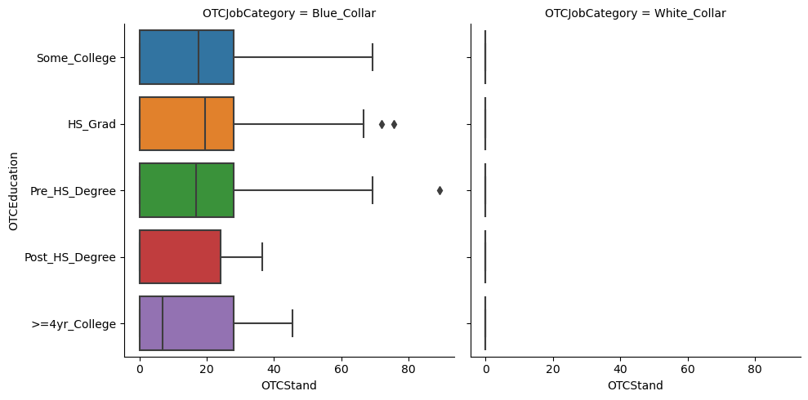
SYNTHETIC DATA GENERATION: GENERATE PROCESS
Job Title
Education * Employment
"White_Collar" or "Blue_Collar"
OTCJobCategory
Dataset assumes there are no medical professionals!!

Slide 15
SYNTHETIC DATA GENERATION: RESULT
Data Model
Model OTC & Exercise
6 labels
Classes
OTCSelect - 32 classes
ExcersiseSelect - 53 classes
235 features
Data Model Improvements
Drop Features that do not improve the model
ZipCode, JobTitle,
Generate new meaningful features
Merge classes together - "Other_Causes" & "Medical" in "Cause"
JobCategory - "White_Collar" or "Blue_Collar"

Slide 16
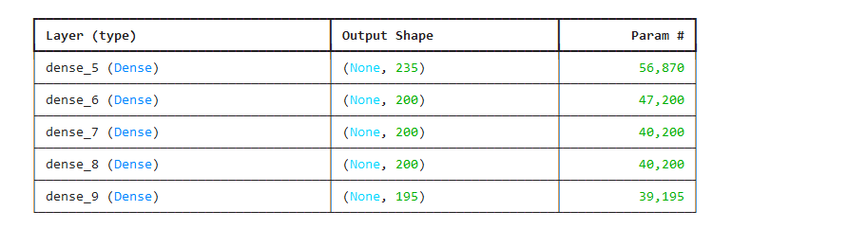
MODEL 1: BACKPROPAGATION NEURAL NETOWRK
Model has approximately 97% accuracy

Slide 17
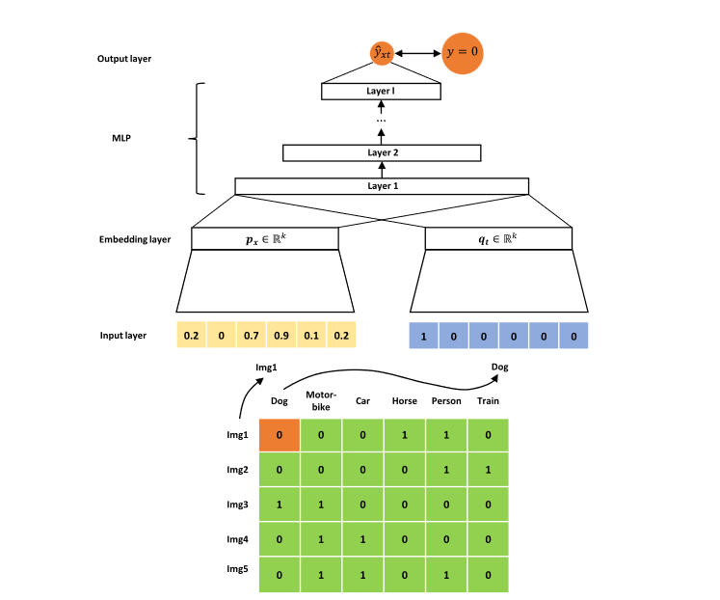
MULTITARGET LEARNING: TWO BRANCH NEURAL NETWORK
DATA MODEL
Model OTC, Exercise and Postpain
PostPain - 6 (Numerical Attribute)
6 labels
Classes
OTCSelect - 32 classes
ExcersiseSelect - 53 classes
235 features
DeepMTP[5]

Slide 18
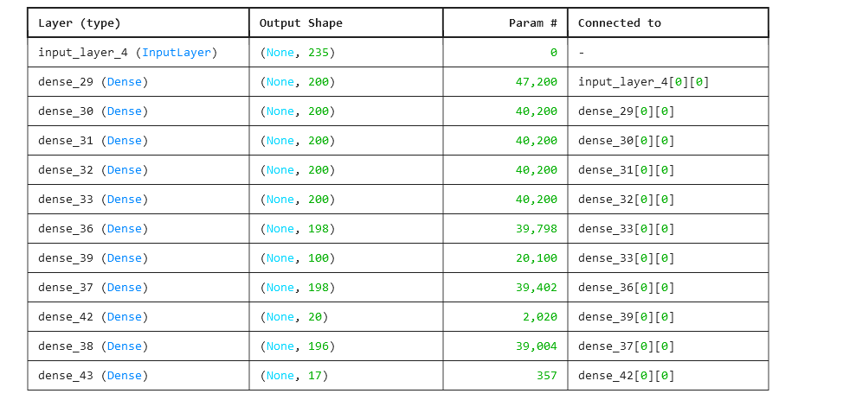
ALTERNATIVE MODEL
DATA MODEL
Model OTC, Exercise and Postpain
PostPain - 6 (Categorical)
6 labels
Classes
OTCSelect - 32 classes
ExcersiseSelect - 53 classes
235 features

Slide 19
SUGGESTIONS
SUGGESTIONS

Slide 20
SUGGESTIONS
OTC and OTC1 data was hand coded, utilize an ml model to generate close variations to it.
Combine classes that would only produce noise.
No current general loss function for predicting regression and classification. Convert Problem domain to Multitarget Classification Model

Slide 21
Thank You!!!

Slide 22
REFERENCES
"Management of Hypertriglyceridemia: Common Questions and Answers," American Family Physician, Nov. 1, 2018. [Online]. Available: https://www.aafp.org/pubs/afp/issues/2018/1101/p576.html.
S. J. M. Merchant, A. C. Li, A. P. Nguyen, M. N. Wirtzfeld, A. E. McLeod, J. S. Park, D. P. Dixon, J. N. Bathe, and A. B. Ball, "Clinicopathologic factors and adjuvant therapy in colonic perforation," Canadian Journal of Gastroenterology and Hepatology, vol. 2016, Article ID 1360345, 6 pages, 2016. [Online]. Available: https://www.ncbi.nlm.nih.gov/pmc/articles/PMC5074793/.
M. Hernandez, G. Epelde, A. Alberdi, R. Cilla, and D. Rankin, "Synthetic data generation for tabular health records: A systematic review," Neurocomputing, vol. 493, pp. 28 - 45, 2022. https://doi.org/10.1016/j.neucom.2022.04.053.
"Multi-label classification," Wikipedia, The Free Encyclopedia. [Online]. Available: https://en.wikipedia.org/wiki/Multi-label_classification.
D. Iliadis, B. De Baets, and W. Waegeman, "DeepMTP: A Python-based deep learning framework for multi-target prediction," SoftwareX, vol. 23, Art. no. 101516, Jul. 2023. [Online]. Available: https://doi.org/10.1016/j.softx.2023.101516.

Slide 23


